Slide 1
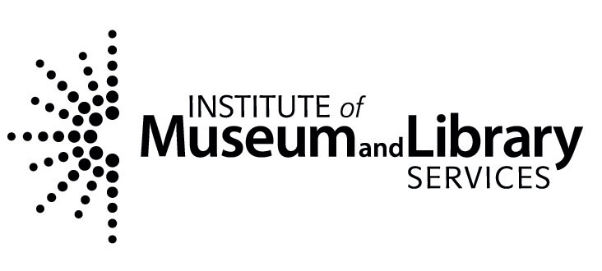
Surveying the People’s Contest
A collaborative program of the
George and Ann Richards Civil War Era Center
and the Penn State University Libraries

Slide 2
Afternoon
Defining the People’s Contest project
The historiography of Civil War era life in the north
Surveying primary collections
Future directions and engagement

Slide 3
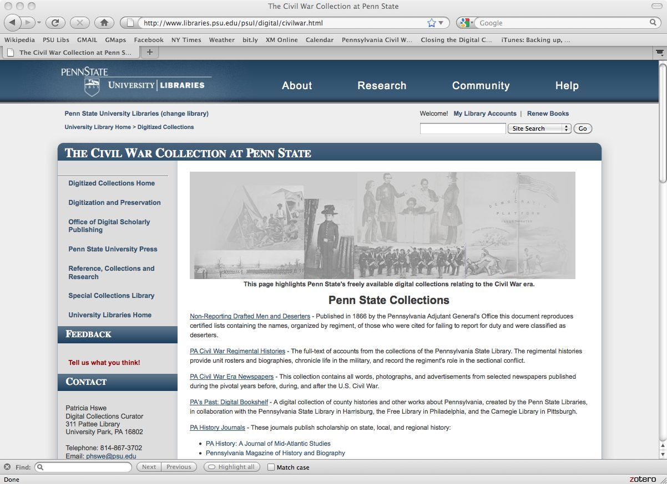

Slide 4
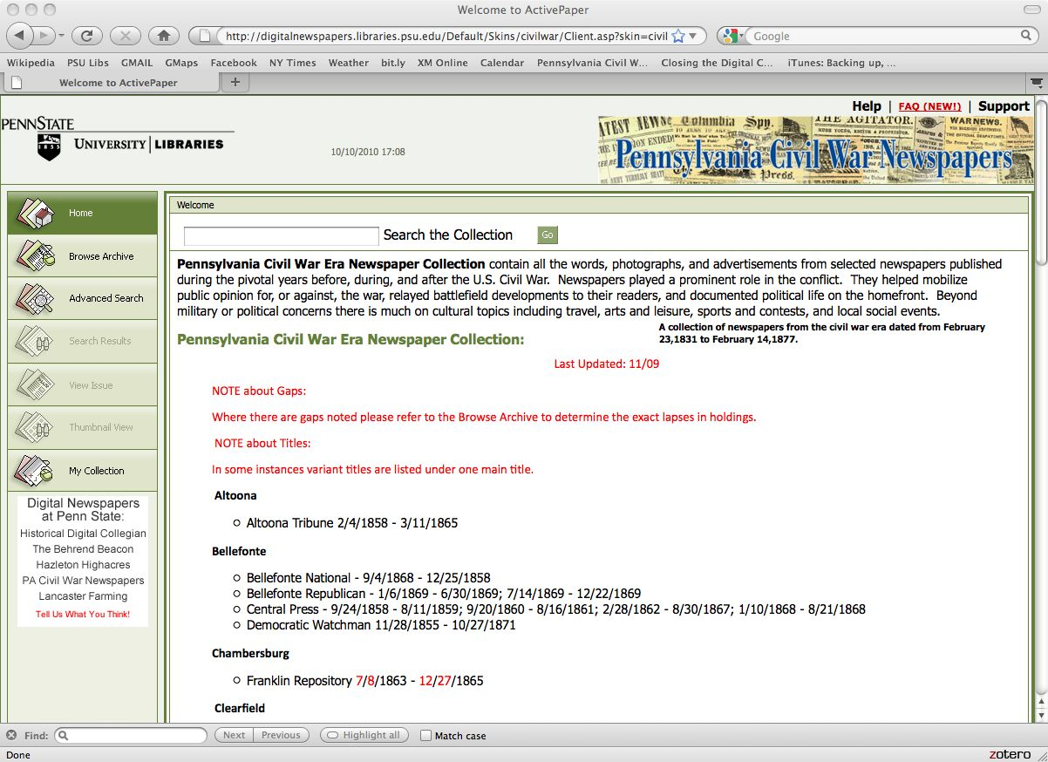

Slide 5
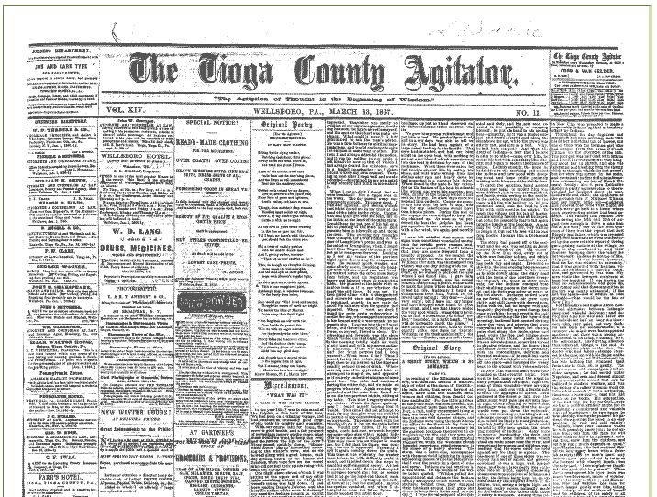

Slide 6
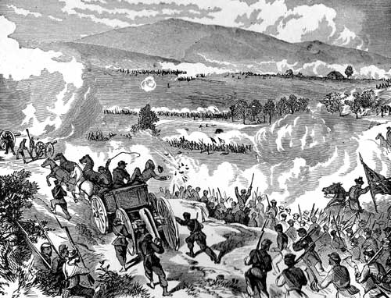
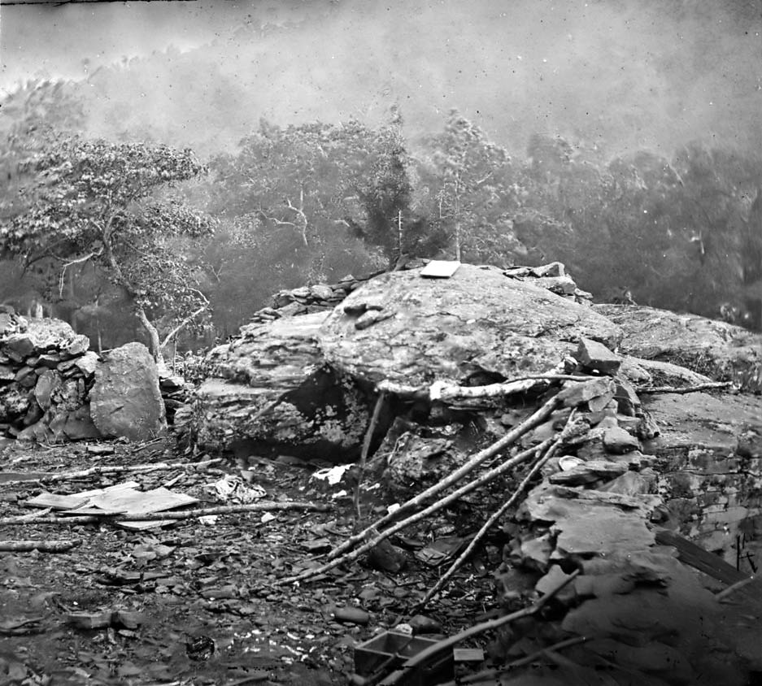
“Civil War Era”

Slide 7
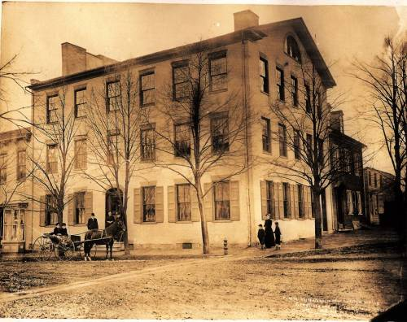
“Civil War Era Homefront”

Slide 8
The Researcher’s Problem
Our understanding of the Civil War North’s economic, social, and cultural history is sorely lacking.
The primary resources to support this research are not well-known, or inaccessible, if they exist at all.
“Why hasn’t all this stuff been digitized yet?”

Slide 9
The Problem for Cultural Heritage Organizations
What is in our collections?
How can we improve access these collections?
Knowing that we are under-resourced, how can we best spend our time?

Slide 10
Some Steps to Take
Establish collaborations among libraries, archives, museums and researchers in the field.
Identify critical needs of users.
Seek and identify primary resources that support the user’s needs.
Use researcher expertise to improve access and prioritize our work.

Slide 11
IMLS Planning Grant
Jointly proposed by The George and Ann Richards Civil War Era Center and the University Libraries at Penn State University.
PIs: Mike Furlough (Libraries) and Bill Blair (Richards Center)
October 2009 – September 2010
Extended to January 31, 2011

Slide 12
Grant Project Partners
Senator John Heinz History Center
Historical Society of Pennsylvania
The Pennsylvania Historical and Museum Commission
The State Library of Pennsylvania

Slide 13
Scholars Advisory Board
J. Matthew Gallman, University of Florida
Judith Geisberg, Villanova University
James Marten, Marquette University
Anne Sarah Rubin, University of Maryland, Baltimore County
Bob Sandow, Lock Haven University

Slide 14
Scoping the Pa. Homefront
Time period:
From the Christiana Riot (1851) through amendments Pennsylvania Constitution (1874).
Topical Issues:
Emancipation, Community, Children, Women and Family, Politics and Government, Commemoration, Religion Ritual, Economy and Work

Slide 15
Planning Grant Deliverables
A qualitative report on the study of the Pennsylvania homefront and researcher needs.
What do know and what questions remain?
A high-level inventory of collections relevant to the study of the Pennsylvania homefront
What exists and what can we say about it?
Assessment of readiness of cultural heritage organizations to provide discovery and access services.
What might it take for us to forward?

Slide 16
Assessing “readiness”
Knowing that time and money are limited
What would improve our ability to enable discovery of and access to our collections?
Are there opportunities for collaboration?
And for leadership?
What do we want funding agencies to know?

Slide 17
Assumptions
Survey and assessment must precede digitizing
Domain researcher expertise is a key to enabling access
Pairing domain research descriptions with archival descriptions will provide a richer experience
Taxonomies or ontology is necessary, but unavoidably imperfect and subject to becoming out-of-date or meaningless to others.
Something is better than nothing

Slide 18
1. The state of the field
What do know and what questions remain?
Matt Isham will report on this

Slide 19
2. The high-level inventory
What exists and what can we say about it?
Sabra Statham will report more on this.

Slide 20
The Inventory: Methodology
Use both archival and researcher expertise
Develop or adapt a survey tool to capture basic information on primary resource collections
Go into the field and test
Iterate the process

Slide 21
Some Activity to Date
Scholar’s Advisory Board met twice to confirm the scope and topics.
Adopted survey instrument developed by the PACSCL Consortial Survey Initiative.
Surveyed collections at 8 number locations.
Working on database cleanup for publication by early 2011.

Slide 22
Questions

Slide 23
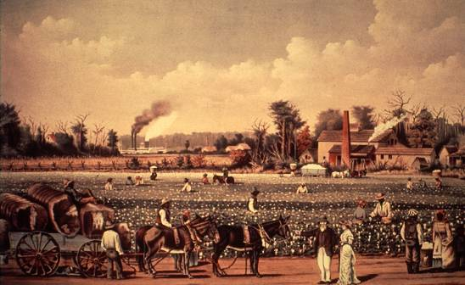
The State of the Field: Focus on the South
Southern Distinctiveness
The Peculiar Institution
Plantation Aristocracy

Slide 24
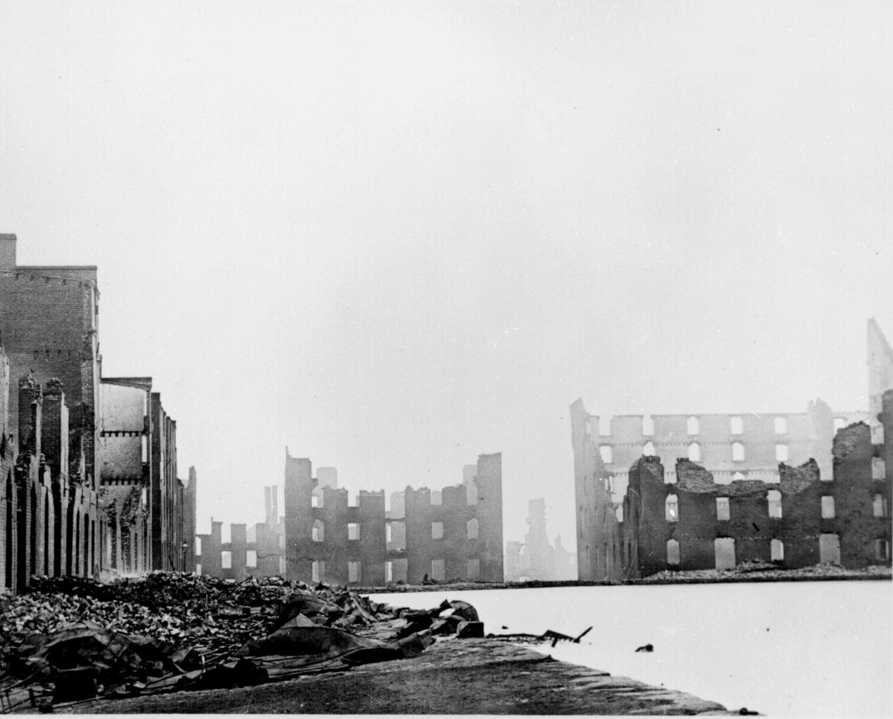
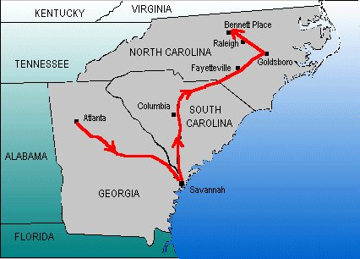
The South in the Civil War
The Impact of War on the Confederacy
Extensive Mobilization
Fighting on Home Soil
Preponderance of Destruction

Slide 25
Major Works on the South in the Civil War Era

Slide 26
Recent Major Works on the North in the Civil War Era

Slide 27
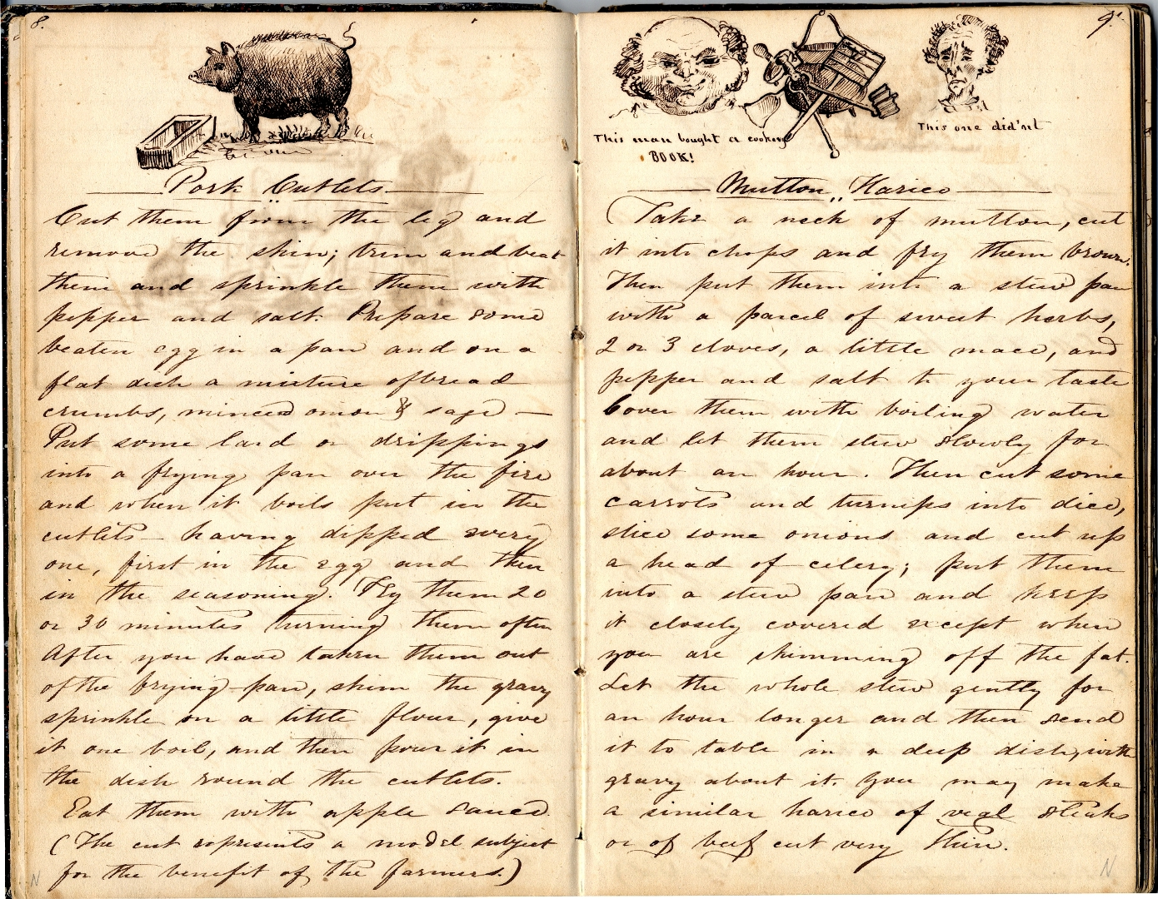
Southern Historical Collection
University of North Carolina
Large and growing archive
Gradual, limited digitization

Slide 28
A People’s Contest Project
A digital analogue to Southern Historical Collection
Community
Commemoration
Economy/Work
Emancipation/Freedom
Household and Family
Mobilization
Politics/Government
Popular Culture
Religion

Slide 29
State of the Field: “Discovering” the North
Hidden Gems
Blair County Historical Society
Life and Labor in the Civil War era North

Slide 30
Questions

Slide 31
The Survey Process
Modeled on the Survey Procedure Used by the PACSCL Group to catalogue uprocessed collections
Three Step Process
Assessment
Survey
Follow Up
Notes:
Survey Process-
Modeled on the PACSCL Survey
Three Step Process
Assessment
Survey
Follow Up

Slide 32
1. Assessment
Initial Contact
Email or Mail
Initial Phone Conversation
First Visit
Introductory Talk
Explore the Repository
Assess Access Issues
Generate a Plan for Conducting the Survey
Notes:
Assessment
Initial Contact
First Visit
Talk
Explore the Repository
Assess Access Issues
Generate a Survey Plan

Slide 33
Archives Surveyed Arranged by Institutional Size
Notes:
Some of the archives we’ve surveyed so far- (Support –financial and workforce= accessibility of collections, ie. Condition of archive storage facilities, preservation, processing, organizing, cataloging and public access)

Slide 34
Access Issues
Are Collections Processed or Not?
Are Collections Catalogued?
Where are the Collections Being Stored?
Do we Have Physical Access to the Site and the Collections?
Notes:
(We are finding that Access is one of the most pressing concerns that we have to deal with in conducting the survey.)
What are Access Issues?
Are Collections Processed?
How are they catalogued? (Are they catalogued?)
Where are items being stored? Conditions?
Are there physical barriers to access? Hours, heat, light, Can we find them?
(Make a plan to conduct the survey)

Slide 35
2. Survey
Physically Handle and Examine Each Collection
Gather basic descriptive information
Notes:
Survey
Physically examine all collections
Take down BASIC descriptive info such as Title, date, condition, contents, genre, names

Slide 36
The Database
Built on a familiar File Maker Pro platform
Can be installed on a laptop computer
Can be shared over a network
Easy to use “fill in the data fields”
Produces records in multiple formats: MARC, xml, pdf, excel
Notes:
Database
Descriptive info entered into the database on site
Database is File Maker
Laptop/portable
Can be shared
Easy to fill in the fields
Generates electronic entries that can be used as is or exported into other standard nationalized databases

Slide 37
Notes:
The Main Menu Page

Slide 38
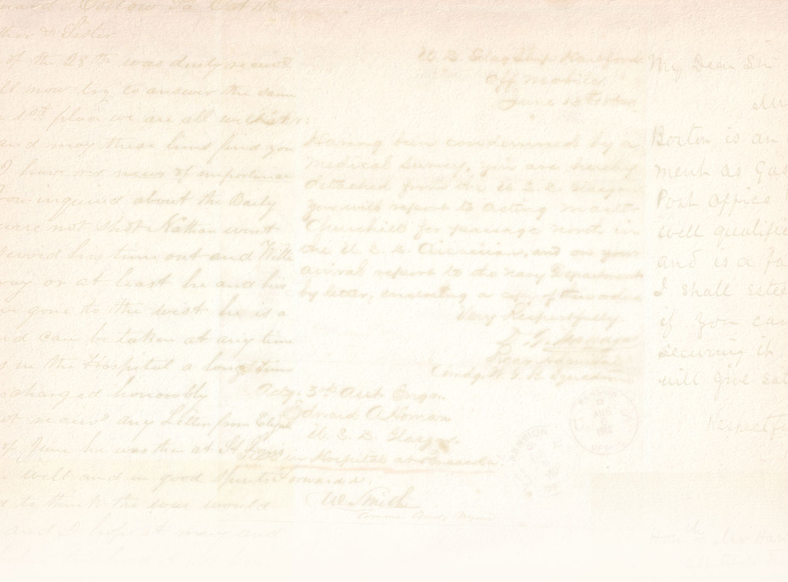
Notes:
Master Record Page Where we enter data

Slide 39
Notes:
Collections list from the database from Blair COunty

Slide 40
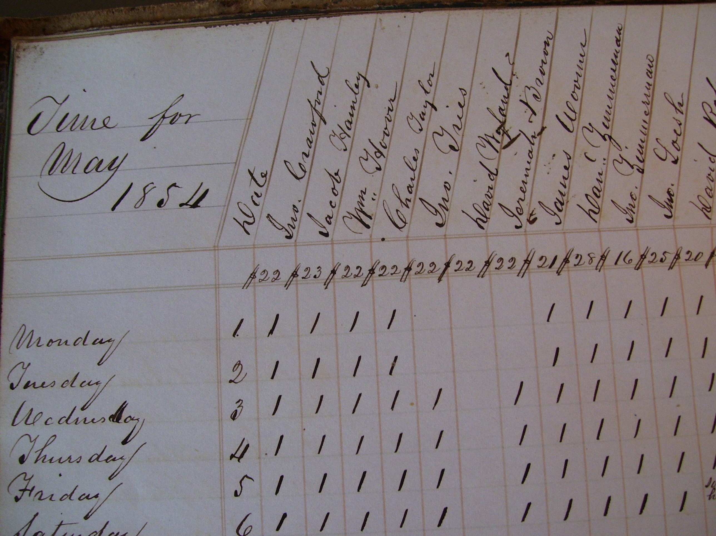

Slide 41
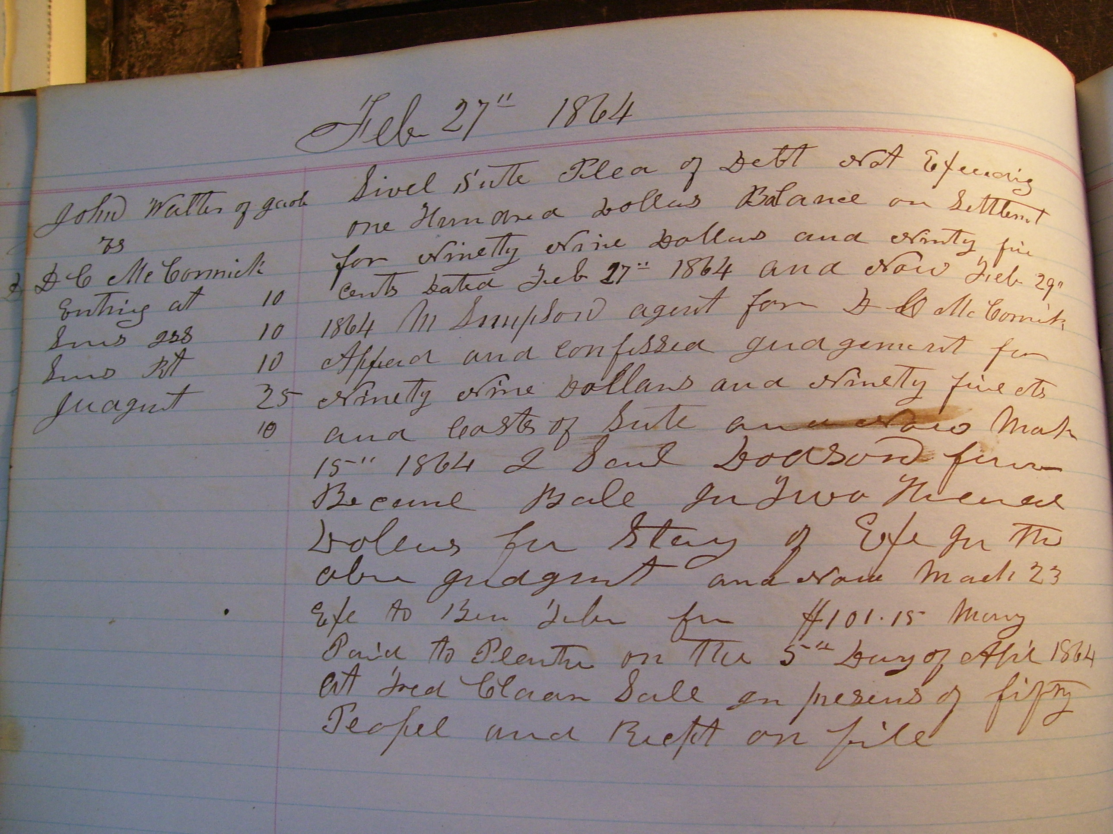
Notes:
Samples

Slide 42
Notes:
Full Collection Record

Slide 43
Notes:
Collections from Heinz History Center

Slide 44
Notes:
More

Slide 45
Notes:
MOre

Slide 46
Notes:
Entry Fields
Survey- Preservation Issues- Time of the survey
Access- IS there a catalogue, Finding Aid, online?
Special Formats- Genres
Abstract
Subjects- Classifications
Local- Where is it located at the archive, how do they identify it

Slide 47
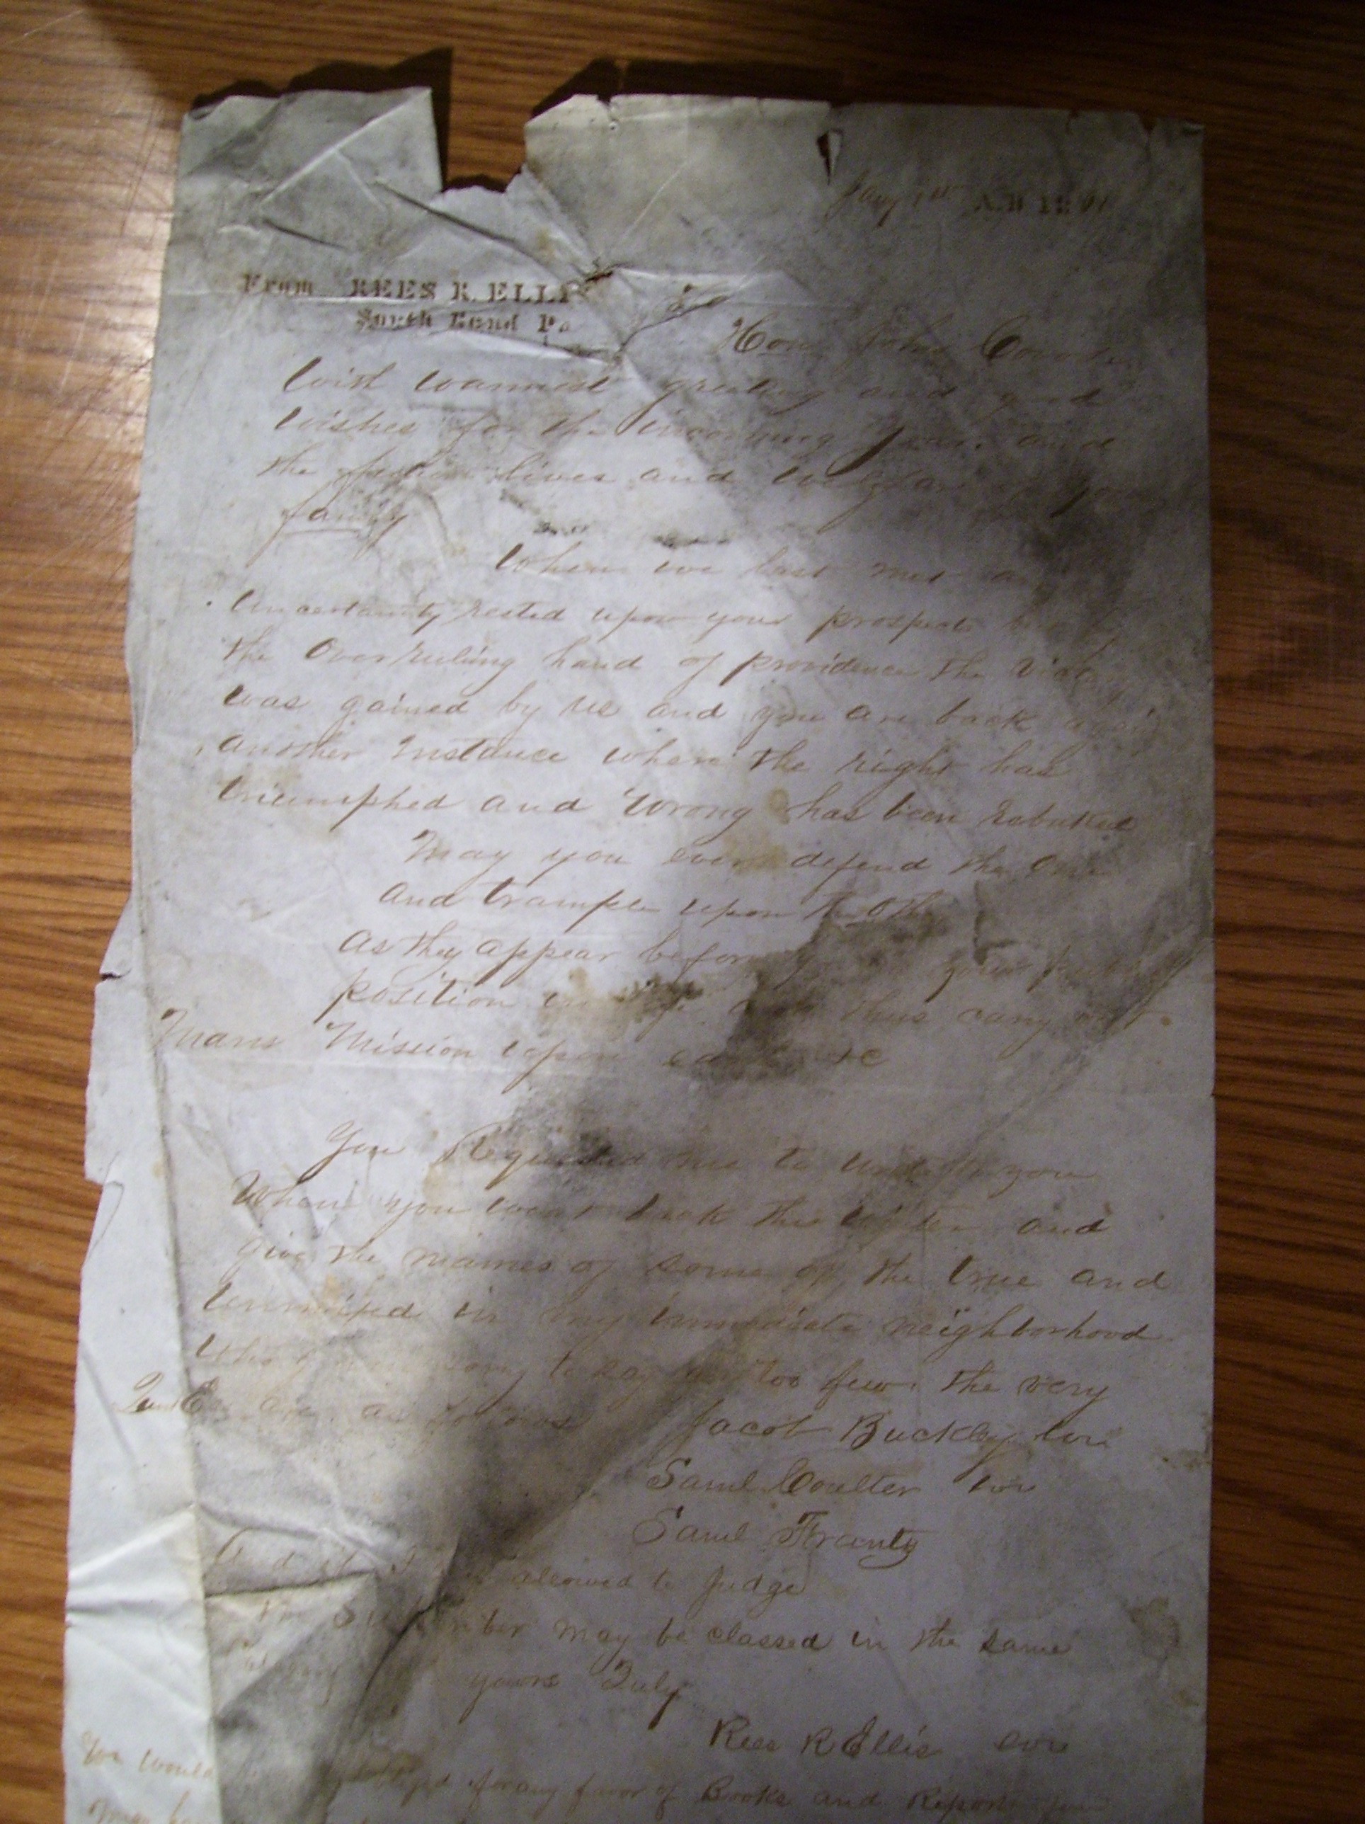

Slide 48
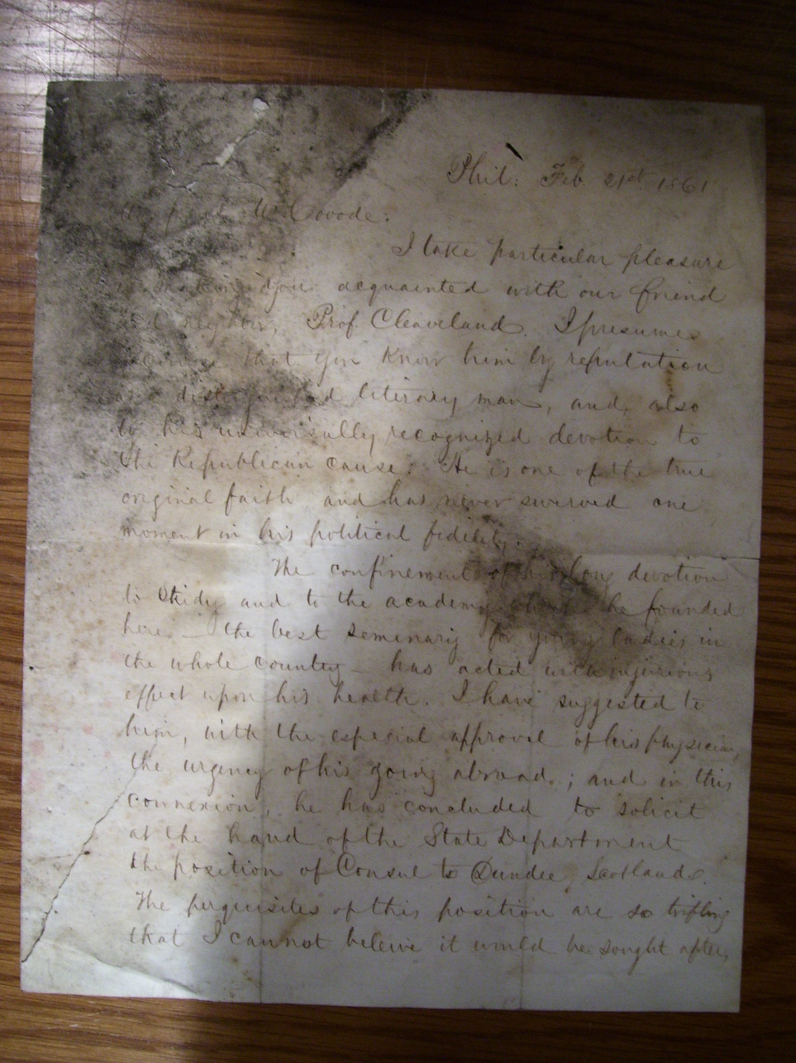

Slide 50
Collections Summary:
267 Total Collections To Date
24 Collections of Correspondence
50+- Collections Legal Documents
4 Biographical Collections
3 Collections of Clippings
3 Collections of Military Documents
10 Collections containing art work or fiction
3 collections of circulars
100+ Financial Records
Notes:
Summary of the Collections we’ve found so far

Slide 51
3. Follow Up
Complete Data Entry and Collection Description
Classify and Tag Collections for Online Searching
Conduct Detailed Assessment of Rare Collections
Notes:
Follow Up
Write Abstracts
Classify Collections for Online Searching
Go back and look closely at rare collections

Slide 52
Enabling Search Functions
Classifying and Tagging:
Genre
Names
Geographic Locations
Topic/Subject
Theme
People

Slide 53
Themes
Emancipation
Community
Children
Women and Family
Politics and Government
Commemoration
Religion
Ritual
Economy and Work
Notes:
Serves to enable search function but also Broadly guide the researcher

Slide 54
People
Soldiers
Women
Workers
Business Owners
Children
Public Servants
Young Adults
African Americans

Slide 55
Other Classifications
Subjects
Over 120 and growing
Scholar generated terms to be synthesized into hierarchical format, made consistent with current library standards
Genres- Letters, Legal Documents, Diaries
Names-
Geographic Locations

Slide 56
Notes:
Entry Fields
Survey- Preservation Issues- Time of the survey
Access- IS there a catalogue, Finding Aid, online?
Special Formats- Genres
Abstract
Subjects- Classifications
Local- Where is it located at the archive, how do they identify it

Slide 57
Detailed Assessment
A Detailed Description of a collection
Its Contents
Its Potential for Use
Its Research Value

Slide 58
Digitization

Slide 59
Survey Workflow

Slide 60
Questions

Slide 61
Assessing “readiness”
Knowing that time and money are limited
What would improve our ability to enable discovery of and access to our collections?
Are there opportunities for collaboration?
And for leadership?
What do we want funding agencies to know?

Slide 62
Longer term issues: The People’s Contest
Focusing our scope and efforts
Engaging and sustaining cross-organizational collaborations
Enabling easy access to our work & collections
Identifying reliable sources of funding
Reaching our audiences

Slide 63
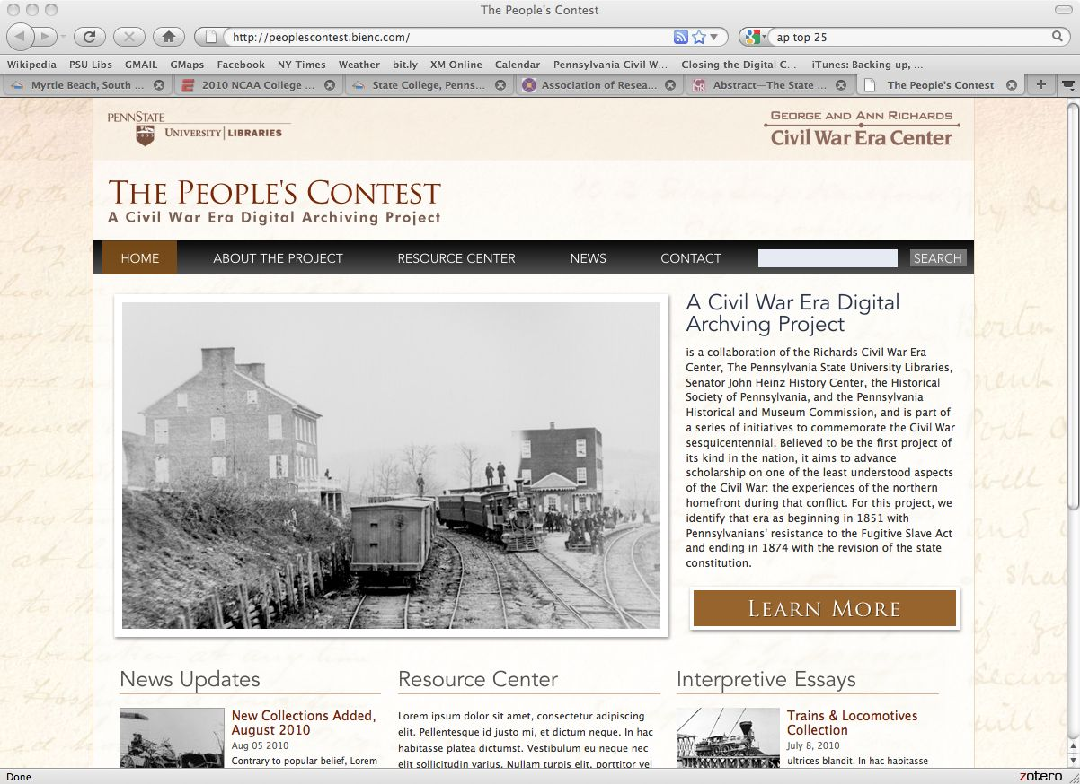

Slide 65
GRAPHICS TO BE PLACED FOLLOW

Slide 66
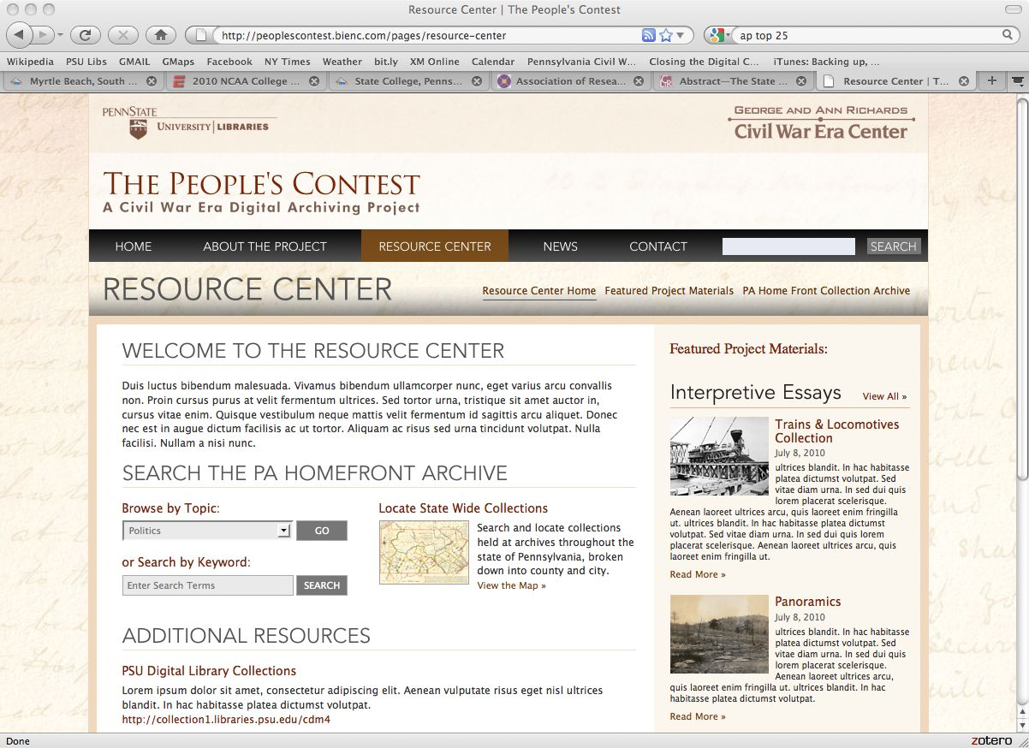

Slide 67
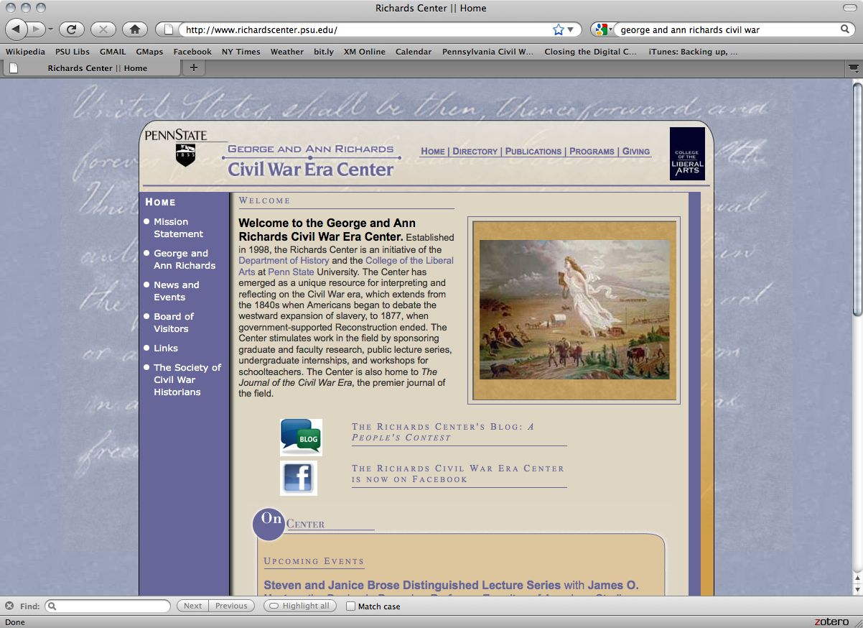

Slide 68
